Slide 1
Online police report system
Nang Wei Lun
2BITI

Slide 2
May 21, the police have launched two new e-portals

Slide 3
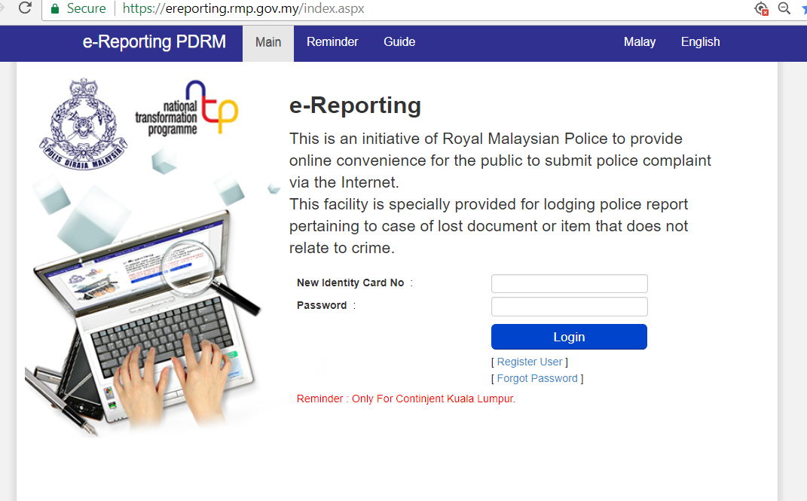

Slide 4
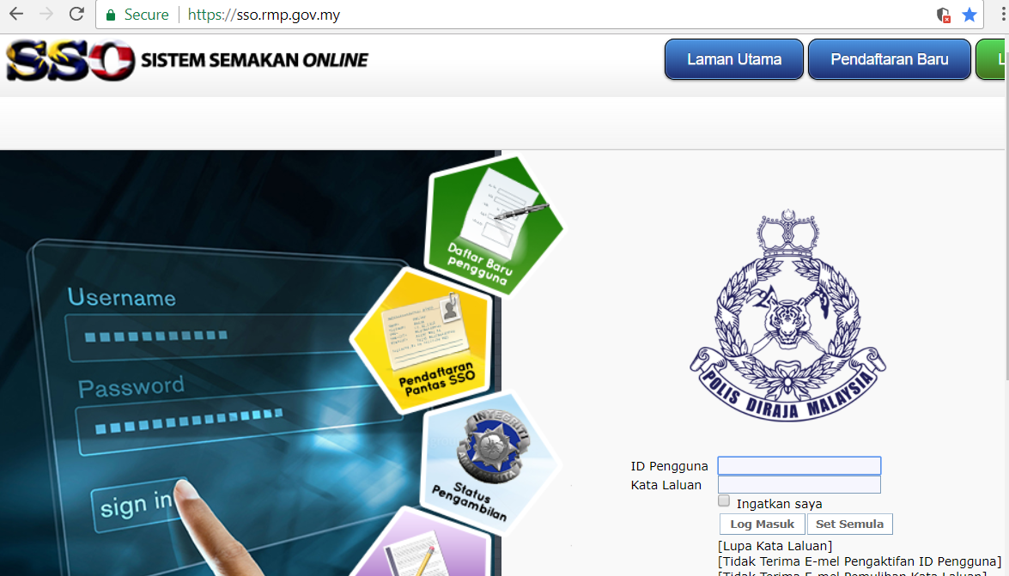

Slide 5
Problem Statement
Crime report stored in paper form is not safe and difficult to search huge data.
Time is wasted when the reporter is searching the nearby police station.
Residents are limited to the information of crime rate in country.
Reporter cannot make police report in silent and they maybe in dangerous.

Slide 6
Objectives
To create a system that store police report data into database and the data is secured, easier to access by police officer.
To develop a system will use server and lets residents to do police report without go to police station.
To generate an analysis for all police report collected in country, and it is accessible by residents and police officer.
To create an online system for residents to make police report online and silently.

Slide 7
thank

